Slide 1

Data representation of foster care in Florida
Felicia Glover
Ian Schuler
LaShanti Jones
Rebeca Rodriguez

Slide 2
Motivation & Summary
Originally interested on the topic of adoption due to a new member of the family
We wanted to discover the recent trends in foster care in the state of Florida
What factors influence successful rates of adoption and ultimately decreases the amount of kids in foster care?
Hypothesis: Less wealthy/developed areas will have larger amounts of children living in foster care and less children finding permanent homes
Were we able to answer these questions to our satisfaction?
No, our data showed us that there may be a lot more factors that did not get accounted for and it is completely possible for there to be variables that effect this topic that are not measurable
Notes:
The idea came into mind because my cousin was recently adopted, and I was intrigued to see just how many factors influence adoption rates and the success or failure of them

Slide 3
Questions & Data
Once we were able to see the influx of children we then had to determine some factors that may have an effect on those numbers such as income & education
To discover the trend of foster care influxes in Florida we had to look at the number of kids being received and taken out of foster care
Notes:
Script:
One of the biggest issues we faced when trying to start this project was finding exactly what kind of data we wanted to use, and how we were going to tell a story with it. There are a lot of discrepancies in data that comes with adoption
Originally I wanted to see what factors make people put kids up for adoption in the first place, but while this information is mostly intuitive, there is not physical data that can be directly related to the rising number of kids being put up.

Slide 4
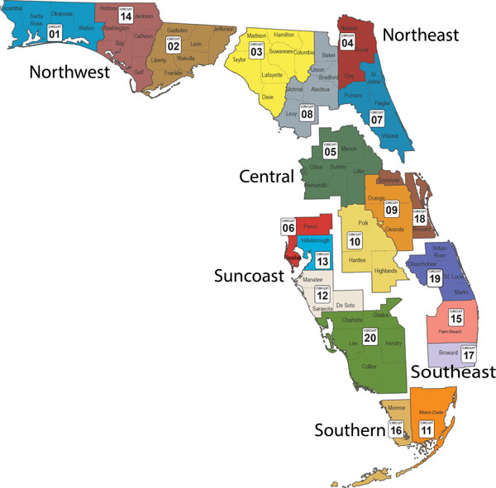
Counties broken into regions of Florida
Most data on foster care was presented on a nation-wide, state-wide, or county-wide basis
To get a closer look at the numbers without having to display data for all 67 counties of Florida, we decided to break down information by region

Slide 5
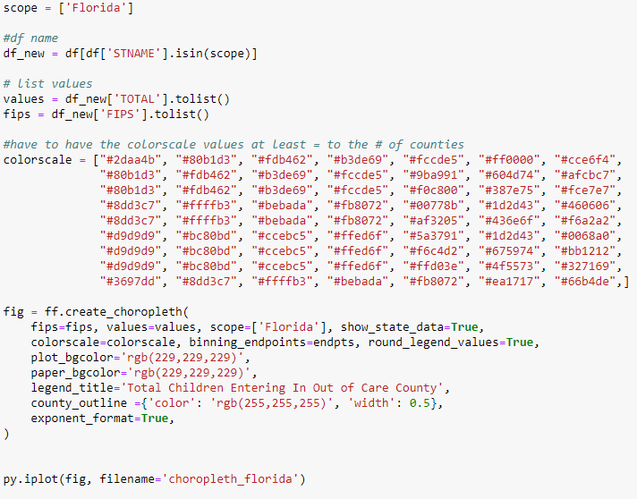
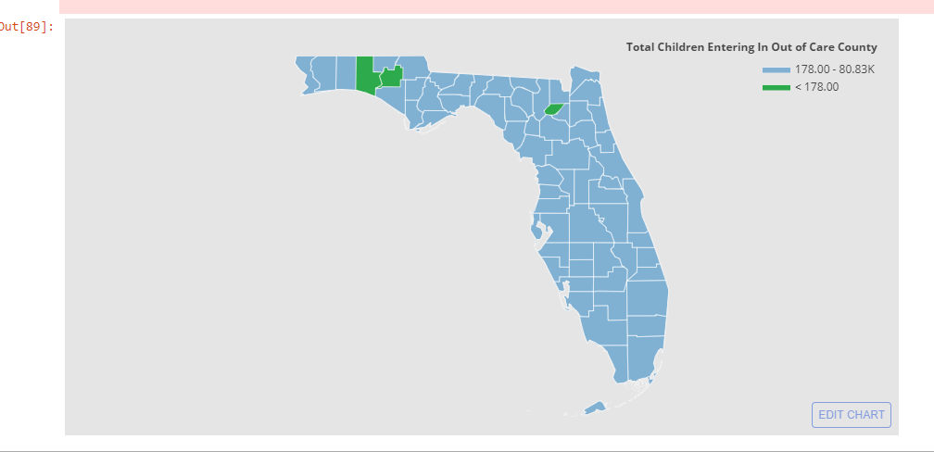
Children Entering Foster Care
https://plot.ly/~phellifel/2/_24214k-us-counties/?share_key=73FRH8XuoEJmWXhFLyU93x#/

Slide 6
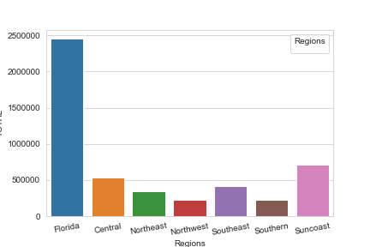
Total kids in foster care by Region

Slide 7
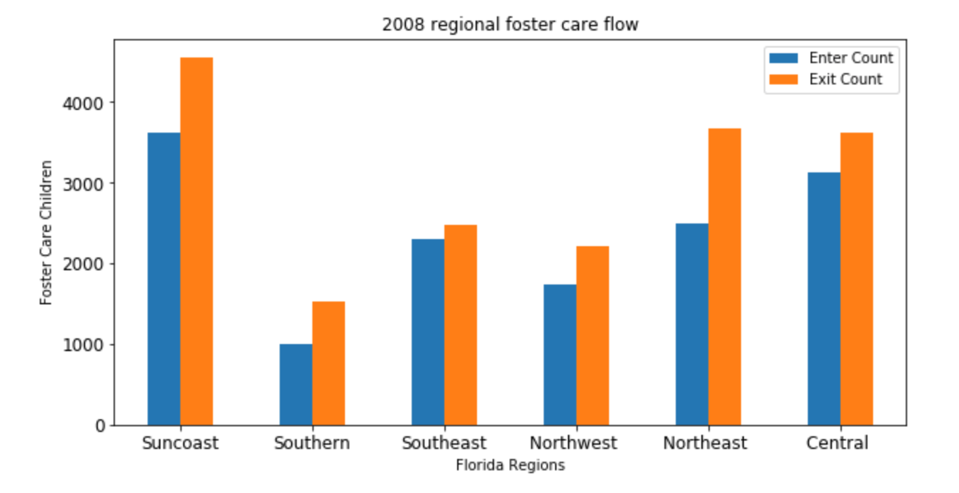
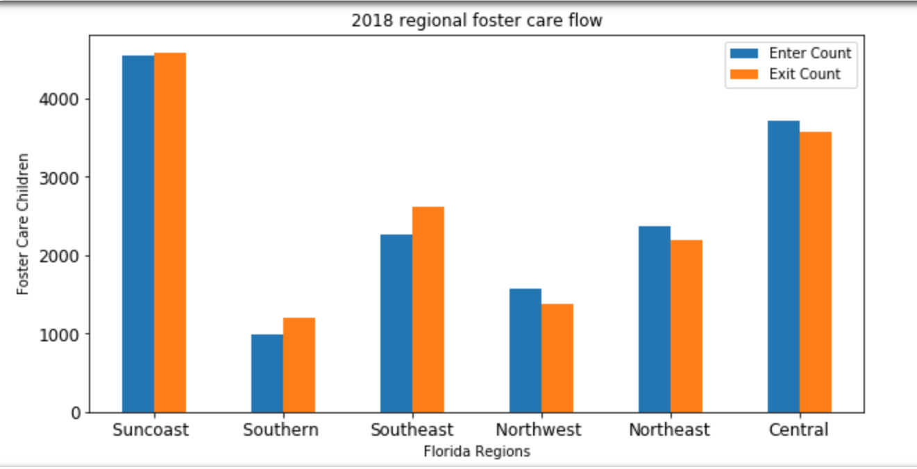
Trend of Adoption Rates
In the past 10 years, the number of kids in foster care has actually gone down collectively. We aimed to see why that was and what we can do to ensure more kids get adopted
Notes:
While some regions did experience a shift in more kids entering than exiting, overall the number of kids in foster care has actually gone down

Slide 8
Defining Permanency
At first, we had a lot of trouble finding data because we did not determine what a “successful” adoption was and what components went along with that
Permanency was determined to be when a child was adopted and stayed in that home until they were of legal age. Many kids in the foster care system may have been adopted but then put back into foster care due to neglect or abuse.
With this now in mind, we were able to explore

Slide 9
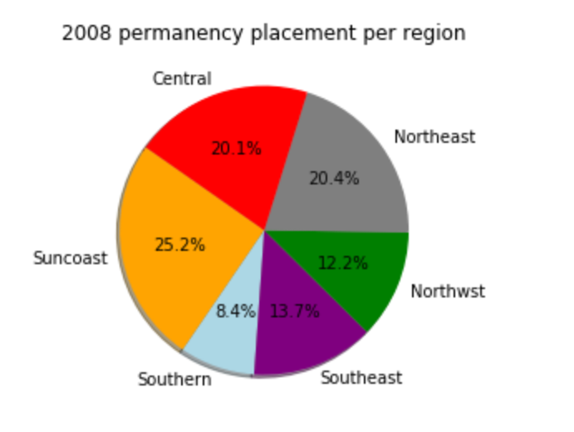
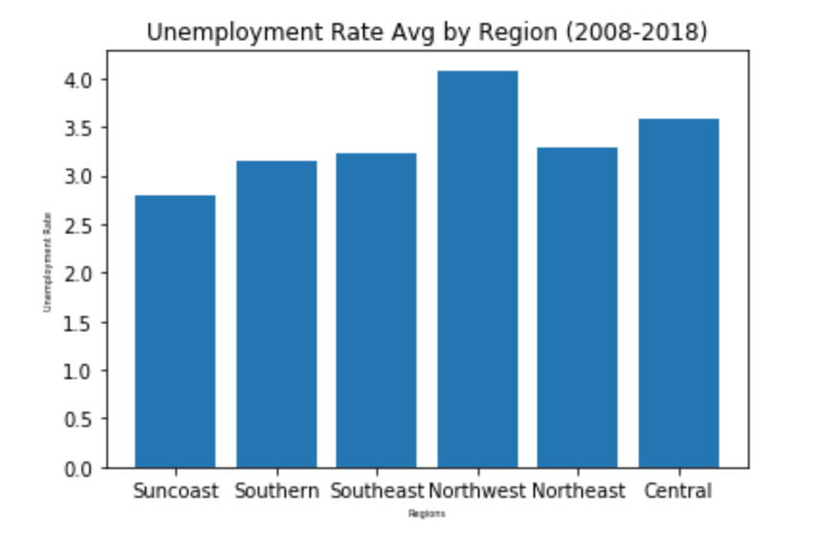
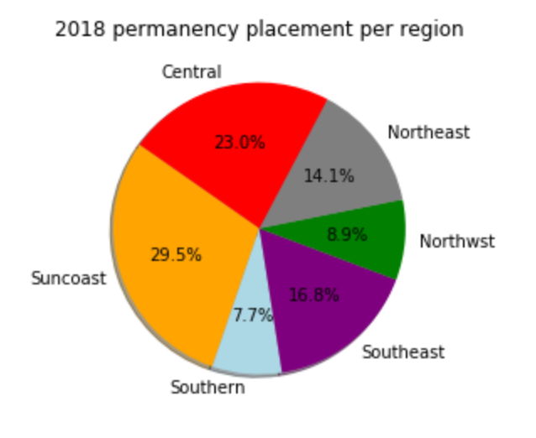
Data Exploration
Influx/Income
The data we wanted to analyze was income/employment. The charts above show that while the Suncoast region had the lowest unemployment, it also in turn was the region that maintained the highest permanency placement amongst foster kids
Notes:
Makes sense. Adopting is expensive. More resources available means more adoptions take place

Slide 10
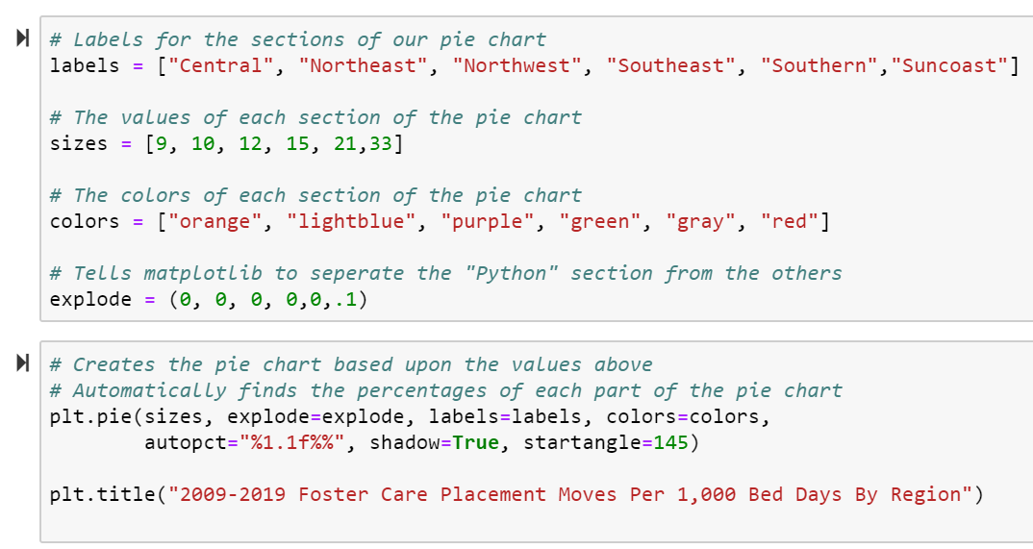
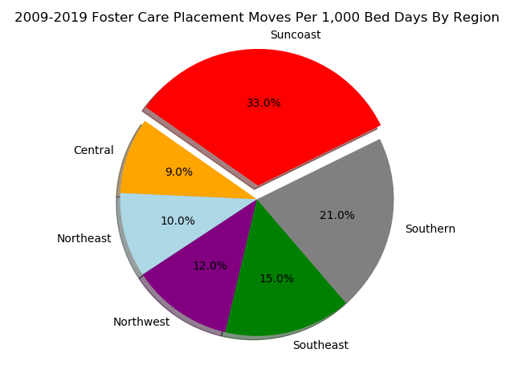

Slide 11
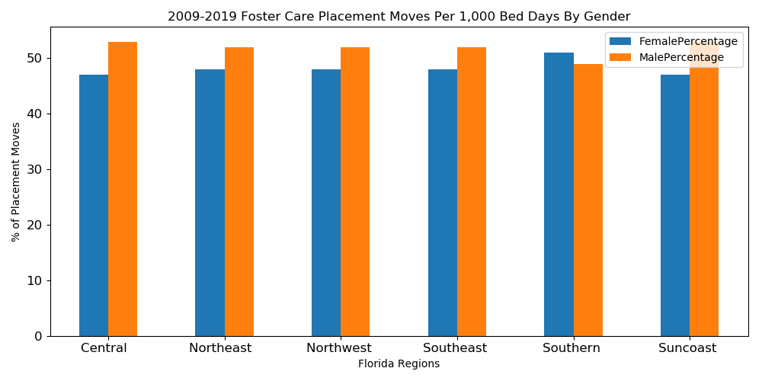
Foster Care Placement by Gender

Slide 12
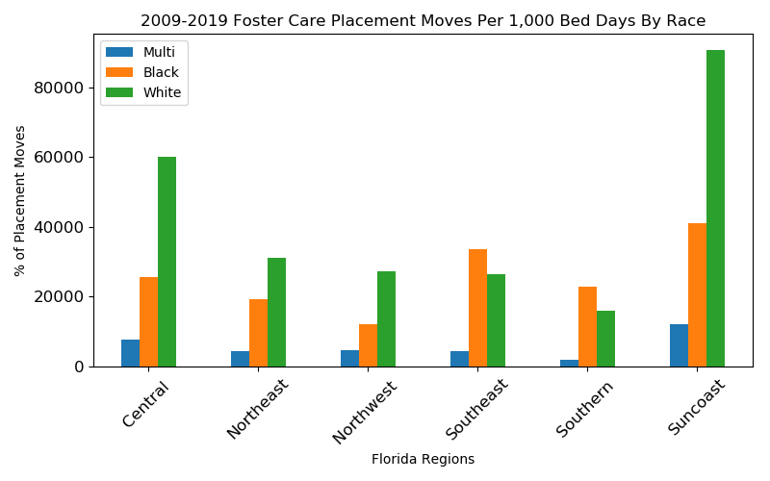
Foster Care Placement by Race

Slide 13
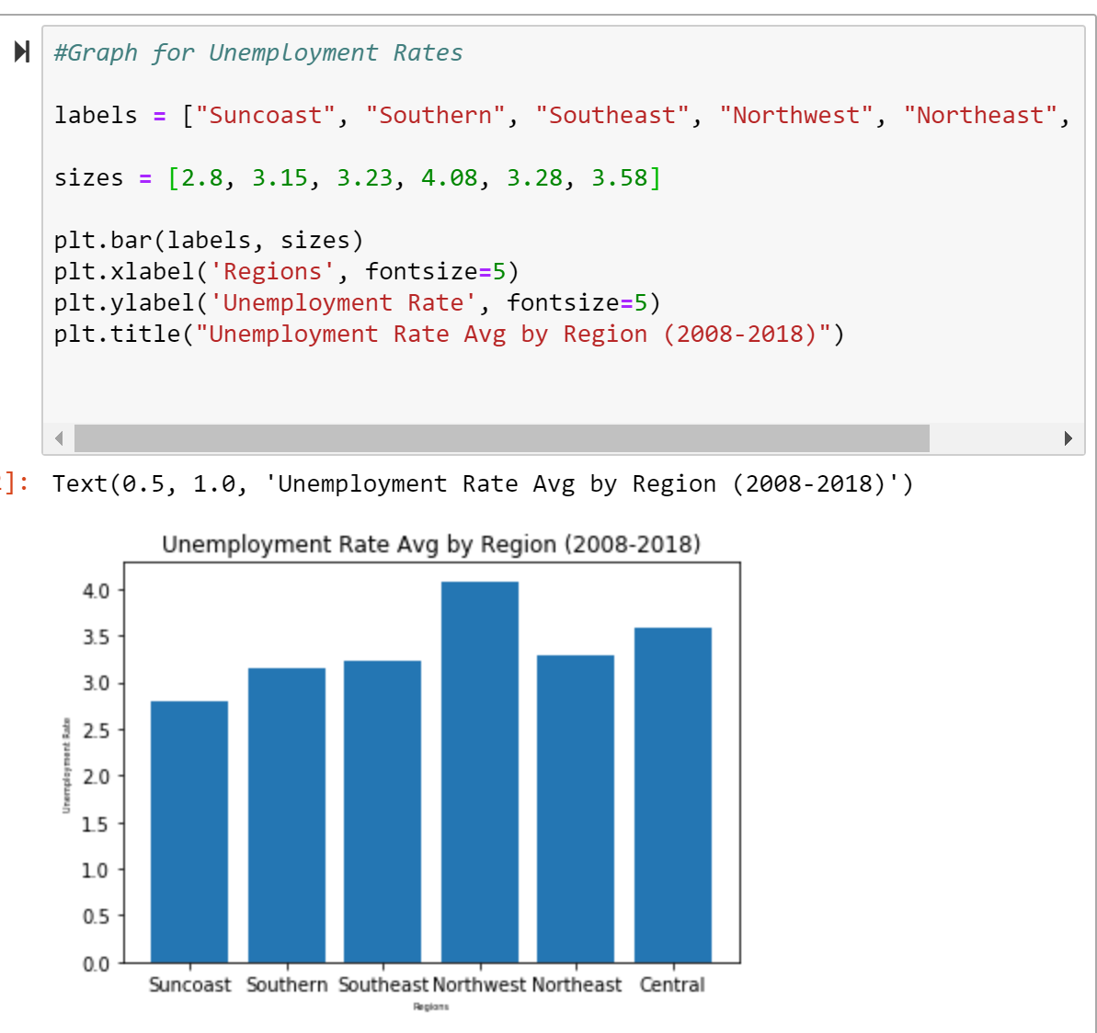
Data Cleanup & Exploration
While dividing data by region allowed us to look at the numbers more clearly than a state overview, it did cause for a lot of manual calculation and inputs which was incredibly time consuming and tedious
In order to display the data without importing all the counties over, the averages were calculated via excel and manually inputted into jupyter

Slide 14
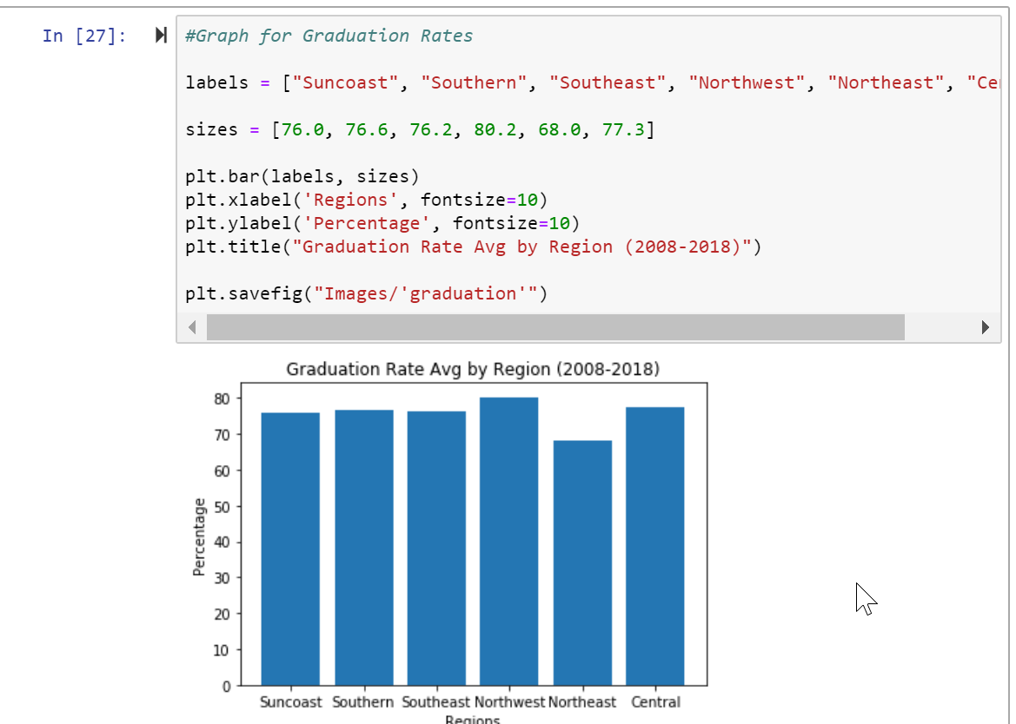
Running into Problems
Sometimes when you go into research, the results you find don’t support exactly what you previously expected, and that’s okay.
One of the main problems that occurred while working with such a broad dataframe was running into data that was not distinguishable enough to tell a story
Upon finding data on the education from region to region, we realized that while different counties can vary on certain things, there a lot of things that remain too similar based on the fact that it is still the same state

Slide 15
Discussion
Sometimes, the answer seems obvious and that can let bias creep in when seeking out an answer that is not what it seems.
It was difficult to pinpoint how these specific factors affected adoption when looking at it from such a broad perspective
After looking at the public data related to foster care, we saw that information that may coincide with the trends of adoption rates does not mean that there is necessarily a direct causation or relationship between the two factors
It is still important to be able to gather this kind of data and look at the concentration of children in certain areas to know where we need to allocate more resources to help reduce those numbers

Slide 16
Post Mortem
The most difficult problem we faced was inconsistent datatypes.
To combat the datatypes differing, a lot of information had to manually be calculated and inputted
We spent a lot of time trying to manipulate the data by region instead of county to show a bigger story, but ended up not having too much distinguishable data
While looking at different regions as opposed to states or counties gave us a different perspective, merging too many different sets of data may have skewed some results
There were a lot of variables that we did not know how to display in a way to tell us about the data
If we had had more time to research, we definitely would have taken more variables into account and may have chosen a specific county or two instead of the entire state

Slide 17
Questions?
Open Q&A

